Slide 1
Driving the Hyde Park BESS cost down: $57M to $43M, and who owns each dollar
Sixteen levers, three gates and a design-to-cost target that take Project 21334 from the $57.2M approval level to a $38.5 to 42.9M re-scoped project, with the decisions leadership is asked to make now
Cost Estimating Center of Excellence | Leadership brief | Basis: ESF Total Rev 3, 24 Sep 2026 | 5 Oct 2026
Internal. Contains vendor-confidential pricing. Backup: Hyde Park BESS Cost Analysis Deck (41 slides).
Notes:
Executive mode. The promise: by the end of this brief leadership can say what will be done to lower the cost, who owns each action, what it is worth and by when. The analysis behind every number is in the 41-slide reference deck, the whitepaper and the workbook; none of it is repeated here.

Slide 2
WHAT CAN BE DONE
The number can be driven from $57.2M to $38.5 to 42.9M. About a third of that needs only a decision.
$57.2M
$50.7 to 52.6M
$38.5 to 42.9M
Approved, Rev 3
Contained: decisions only
Re-scoped after four studies
24 Sep 2026; includes $7.6M of risk and contingency and $20.3M of loaders
Six decisions, no scope change, no study, by the November 2026 PAF
Geotech, hosting capacity, the Station 496 protection basis, the Haugland scope map; Q1 2027
▪ Decide now (no study): $4.9 to 7.0M loaded. Strike the escalation on a fixed price, re-word two risk lines that duplicate it, rule on the overhead basis, strike the double-counted disconnects, pay the battery at delivery.
▪ Decide after a study (Q1 2027): $10.6 to 13.1M loaded. Engineering's proposal (Station 496 to RTU, RTAC and transfer trip only; two feeders instead of four), civil sized after geotech, a crew build-up for install.
▪ Outside the estimate, larger than both: $11.2 to 16.5M of Section 48E credit on the revenue requirement, plus $2.8 to 4.1M if the landfill qualifies as an energy community. Owner: Tax.
▪ Then hold it: a station-direct design-to-cost target of $1,250 per kWh ($50M loaded), competitive lump-sum pricing before construction, and a monthly number someone owns.
EstimatingCoE | Eversource Energy | Stewards of Affordability
2
Notes:
The three numbers are the scope-challenge cases (scope_challenge.json). The honest planning range once the Haugland reconciliation and the unpriced exposures are added back is $44.5 to 54.8M; it is on slide 9, not here, because the question in the room is what can be done, and the answer is the two groups of decisions plus the target.

Slide 3
THE LEVERS, GROUPED BY WHAT THEY NEED
Where the dollars come from: a bridge from the approval level to the re-scoped project, loaded
Group | Loaded
Decide now, 6 levers | $4.9 to 7.0M
After a study, 8 levers | $10.6 to 13.1M
Subtotal, the estimate | $15.4 to 20.1M
Exposures to add back | -$2.0 to 3.9M
Haugland gap, direct | -$4 to 8M
48E and adder, revenue req. | $11.2 to 16.5M
Midpoints plotted. Every lever is sized from the Rev 3 line items and loaded at the marginal loader of 1.44 (contingency, basis-driven indirects and AFUDC scale with directs). The two red steps are not levers: they are what must be managed so the savings stick (slide 9).
EstimatingCoE | Eversource Energy | Stewards of Affordability
3
Notes:
Bridge built from savings.json and scope_challenge.json. The 'honest planning midpoint' is the net case: re-scoped, plus the exposures the estimate does not carry, plus the Haugland midpoint loaded. The 48E credit is not on the bridge because it reduces the revenue requirement, not the project cost.

Slide 4
GROUP 1: DECISIONS, NO STUDY
Decide now, before the November PAF: six levers worth $4.9 to 7.0M, none of which changes scope
# | Lever | Loaded | Odds | What it takes | Owner | By
A1 | Strike the escalation carried on the fixed-price battery | $1.6M | 80% | Decision; Exhibit C read for pass-through | Cost Estimating / Sourcing | Nov 2026
A2 | Re-word two risk lines that duplicate that escalation | $1.3 to 1.8M | 70% | Re-word and re-size the two lines | Cost Estimating + PM | Nov 2026
A4 | Take the E&S overhead basis off the vendor contract | $1.0 to 2.1M | 30% | Accounting ruling | Accounting / Cost Estimating | Nov 2026
A5 | Split commissioning hours with Nomad in the test plan | $0.2 to 0.5M | 50% | Test plan split written | Capital Projects Eng. + Nomad | Nov 2026
B5 | Strike the disconnects and PTs the Siemens skids already carry | $0.4M | 90% | Siemens confirms skid scope in writing | Substation Eng. + Cost Estimating | Nov 2026
C3 | Pay the battery at delivery, not a year ahead (AFUDC) | $0.3 to 0.7M | 50% | Nomad milestone schedule in the SOV | PM + Sourcing + Treasury | Nov 2026
 | Total | $4.9 to 7.0M
▪ The ask: approve these six as estimate corrections for the November 2026 PAF. The odds are the simulation's assessed probability of each landing; the expected value of the six is about $3.9M.
EstimatingCoE | Eversource Energy | Stewards of Affordability
4
Notes:
Group 1 is estimate hygiene plus one commercial term (C3). A1: the Nomad price is fixed until Final Acceptance, so the $1.13M escalation on the unpaid balance is not a cost. A2: two risk-register lines describe the same escalation in words. A4: whether the E&S station overhead basis should load a vendor-furnished, vendor-commissioned contract is an Accounting ruling. B5: the Siemens budgetary quote of 12 Aug 2026 includes disconnects, PTs, relays and cabinets in the $300K skid price; Rev 3 carries them again. C3: paying at delivery rather than a year ahead changes AFUDC.

Slide 5
GROUP 2: DECISIONS THAT NEED A STUDY
Decide at Gate 1 (Q1 2027): eight levers worth $10.6 to 13.1M, each closed by a study already on the critical path
# | Lever | Loaded | Odds | What closes it | Owner | By
A3 | Confirm the four design-basis items Haugland priced as deducts | $0.9 to 1.2M | with T1 | Haugland-to-Rev 3 scope map, signed | Substation Engineering | Q1 2027
B1 | Station 496: relay program out; RTU, RTAC and transfer trip only | $6.1 to 6.6M | 60% | Protection-basis memo; RTU/RTAC scope priced | P&C Engineering + System Protection | Dec 2026
B2 | Two feeders instead of four: two skids, two metering sets, two duct-bank runs | $1.5 to 1.7M | 60% | Hosting-capacity study at 5 MW per feeder; N-1 accepted | System Planning + Substation Eng. | Q1 2027
B3 | Size the platform and wall after geotech, not before | $0.4 to 1.2M | 40% | Geotech report; MassDEP post-closure conditions | Civil + Capital Projects Eng. | Q1 2027
B4 | Battery install labor from a crew build-up | $0.7 to 1.1M | 60% | Crew build-up with Nomad and HEG | Cost Estimating + Nomad + HEG | Q1 2027
B6 | GSU install hours and count settled in writing | $0.3 to 0.3M | 60% | Topology and GSU count in writing | Substation Eng. + Nomad | Q1 2027
B7 | Lighting to the security need, not 12 HPS luminaires | $0.2 to 0.3M | 70% | Lighting design | Substation Eng. | Q1 2027
B8 | Siting and PM task budgets from outside counsel | $0.5 to 0.8M | 40% | Task budget from outside counsel | Siting + PM | Q1 2027
 | Total | $10.6 to 13.1M
▪ The ask: fund and schedule the four closers now (geotech, hosting capacity at 5 MW per feeder, the Station 496 protection-basis memo, the Haugland scope map) so every one of these is decided before IFC, not discovered after.
EstimatingCoE | Eversource Energy | Stewards of Affordability
5
Notes:
Group 2 is value engineering. The biggest single item, B2, is a two-feeder interconnection if the hosting-capacity study says two feeders carry 5 MW each; it removes two breaker skids, two GSUs and two metering sets. B1 benchmarks the 710 man-hours per relay at Station 496 against two recent EMA relay-replacement actuals. B3 is the platform and retaining wall, sized today on a 2.5 ft fill placeholder.

Slide 6
GROUP 2, THE TWO LARGEST LEVERS, ON ONE MEMO AND ONE STUDY
Engineering's 5 Oct proposal is worth $7.6 to 8.3M: Station 496 to RTU, RTAC and transfer trip only, and two feeders
$6.1 to 6.6M
$1.5 to 1.7M
$42.4 to 45.0M
Station 496, net
Two feeders, loaded
Contained case plus this
$7.25M relay program out; $0.7 to 1.1M kept for the RTU, RTAC and transfer trip, which Rev 2 names but does not price
Two breaker skids, two metering sets, two duct-bank runs, two riser-pole pairs; four GSUs unchanged
The six no-study decisions and the proposal; nothing else in the register
What makes it real | Owner | By | What it decides
Protection-basis memo: the existing SEL-551 and REF610 relays plus an RTAC transfer trip over the dark fiber meet the interconnection requirement | System Protection | Dec 2026 | Without it the $7.25M stays
Price the RTU, RTAC/Axion, panel, fiber terminations and point lists (named in Rev 2, no line) | P&C Eng. + Cost Estimating | Nov 2026 | Allowance of $0.30 to 0.55M direct until then
Asset-condition check on the legacy relays | Asset Management | Dec 2026 | If they must go anyway, the cost moves to that program; customers do not save it
Hosting-capacity and protection study at 5 MW per feeder; N-1 position accepted in writing | System Planning | Q1 2027 | Two feeders, and whether voltage mitigation is needed ($0.2M to $0.5M exposure)
D-Line 24211 re-scoped to two tie-ins | Distribution Eng. | Q1 2027 | Outside 21334; the 2023 $4.8M memo shrinks too
▪ The honest reading: the largest single lever in the register and about a quarter of the simulated variance on its own. It is a saving to customers only if the relays were BESS-driven scope; say which before it goes in the PAF.
EstimatingCoE | Eversource Energy | Stewards of Affordability
6
Notes:
Engineering's proposal was raised on 5 October 2026 after the leadership brief was built. Sizing: the Station 496 Rev 2 estimate ($7.25M on $3.90M of directs, loader 1.86) is entirely the 20-relay program and its loaders; it contains no line for the RTU (Orion+), the SEL RTAC/Axion or the dark-fiber transfer trip, although its clarifications name all three. The allowance of $0.30M to $0.55M direct covers hardware, panel, fiber terminations, 400 to 600 engineering hours, 300 to 500 install hours and 400 to 800 test hours; PM and internal siting hours are retained. Two feeders: half the lines that follow the feeder count (breaker skids, metering transclosures, duct bank to the feeder manholes, riser poles; the cable share at the high end); disconnects are excluded because B5 strikes them. Odds in the simulation: 60% each.

Slide 7
GROUP 3: REVENUE REQUIREMENT
The largest lever is not in the estimate: $8.4 to 12.4M of Section 48E credit to customers, and nobody owns it yet
$8.4 to 12.4M
+$2.8 to 4.1M
65%
30% credit, eligible basis
Energy-community adder
Non-PFE cost ratio
Battery, install, balance of plant ($28M); up to $41M with station, site and testing
Only if the closed landfill qualifies as a brownfield; not assumed
Cell origin on the Voyager units decides whether the credit is zero
Decision | Owner | By | Why it matters
Eligible-basis opinion: which layers are energy storage property | Tax | Dec 2026 | Sets the $28M to $41M range
FEOC cost-ratio test on the Nomad cells (Notice 2026-15) | Tax + Sourcing + Nomad | Before final drawings | A failed test is a zero credit
Normalization election; DPU treatment of the credit | Regulatory | 2027 filing | Decides how fast customers see it
Prevailing wage and apprenticeship in the construction contracts | Sourcing + Construction | Gate 3 | 6% credit becomes 30%
▪ The ask: open the 48E memo with Tax this month. It is larger than every estimate lever combined and it has a construction-start deadline.
EstimatingCoE | Eversource Energy | Stewards of Affordability
7
Notes:
Section 48E storage credit for a utility-owned, 2028 construction start: 30% base with prevailing wage and apprenticeship; prohibited-foreign-entity restrictions phased in by begin-construction date; the IRA added an election out of normalization for storage. Confidence medium on the mechanism (law-firm summaries of the July 2025 reconciliation law and Notice 2026-15), low on the dollars until Tax opines. Research pass of 3 Oct 2026 logged in the research log.

Slide 8
GATE 2: DESIGN-TO-COST (BEFORE IFC, MID-2027)
Hold it: a station-direct target of $1,250 per kWh, $50M loaded, with change control and a monthly number
$1,250/kWh
$1,483/kWh
$50M
Station-direct target
Where Rev 3 sits
Loaded target
$25M direct: the reference-class 75th percentile for a built project this size
$29.7M direct, the 77th percentile of 35 built projects at or below 100 MWh
The contained case, held through IFC, construction pricing and in-service
▪ Why a target and not a forecast: an estimate that is re-forecast every revision has moved from $43.9M to $57.2M in three years. A target with change control turns it into a managed number.
▪ The rule: no scope is added without a funded source. A change control board with the CoE decides every addition against the target, in writing.
▪ The measure: station-direct $/kWh against target, forecast at completion, open scope questions, the exposures register. One page, monthly, to the sponsor, until in-service.
▪ Why this level: it is defensible outside the company. A regulator can be told the project was designed to the 75th percentile of what utilities have actually built, and why it stopped where it stopped.
EstimatingCoE | Eversource Energy | Stewards of Affordability
8
Notes:
Target from scope_challenge.json: the reference-class 75th percentile of station-direct $/kWh, rounded to $50. The reference class is the 35 built projects at or below 100 MWh verified on 5 Oct 2026 via EIA-860M and regulator records. The monthly report is the standing item in the containment plan.

Slide 9
GATE 3: COMMERCIAL STRATEGY (Q3 2027)
Buy it differently: competitive lump-sum pricing before construction, owner-furnished equipment, a change-order cap
Action | What it changes | Owner | By
Competitive lump-sum pricing for station, civil and install: Haugland plus two bidders | Converts a unit-library estimate at 30% engineering into a bid; retires the +25% construction stress test | Sourcing + PM | Q3 2027
Owner-furnished GSUs and breaker skids on alliance pricing | Takes contractor markup off $3.8M of equipment; locks the 29 to 70 week transformer lead time | Sourcing + Substation Eng. | Q2 2027
Nomad payment milestones aligned to the January 2028 delivery | Removes a year of AFUDC on $12M; protects the siting float | PM + Sourcing + Treasury | Nov 2026
Change-order cap and a tariff pass-through clause read before signature | Bounds the $0.6M Nomad change-order exposure in the simulation | Sourcing + Legal | Nov 2026
Outage windows at Station 496 priced explicitly for whatever work remains | Unpriced today; small if the relay program goes | P&C Eng. + EMA | Gate 1
▪ The ask: approve the contracting strategy at Gate 3 rather than defaulting to the alliance contractor on unit rates. The simulation's two largest accuracy ranges, the civil layer and Station 496, are both unit-library numbers with no bid behind them.
EstimatingCoE | Eversource Energy | Stewards of Affordability
9
Notes:
The civil layer (E) and Station 496 (F) carry the widest two-sided accuracy ranges in the integrated Monte Carlo (-$0.9M to +$2.6M and -$1.1M to +$2.0M). A competitive lump-sum converts that range into a contract price. Owner-furnished GSUs and skids match the Siemens budgetary quote of 12 Aug 2026 and the transformer lead-time guidance.

Slide 10
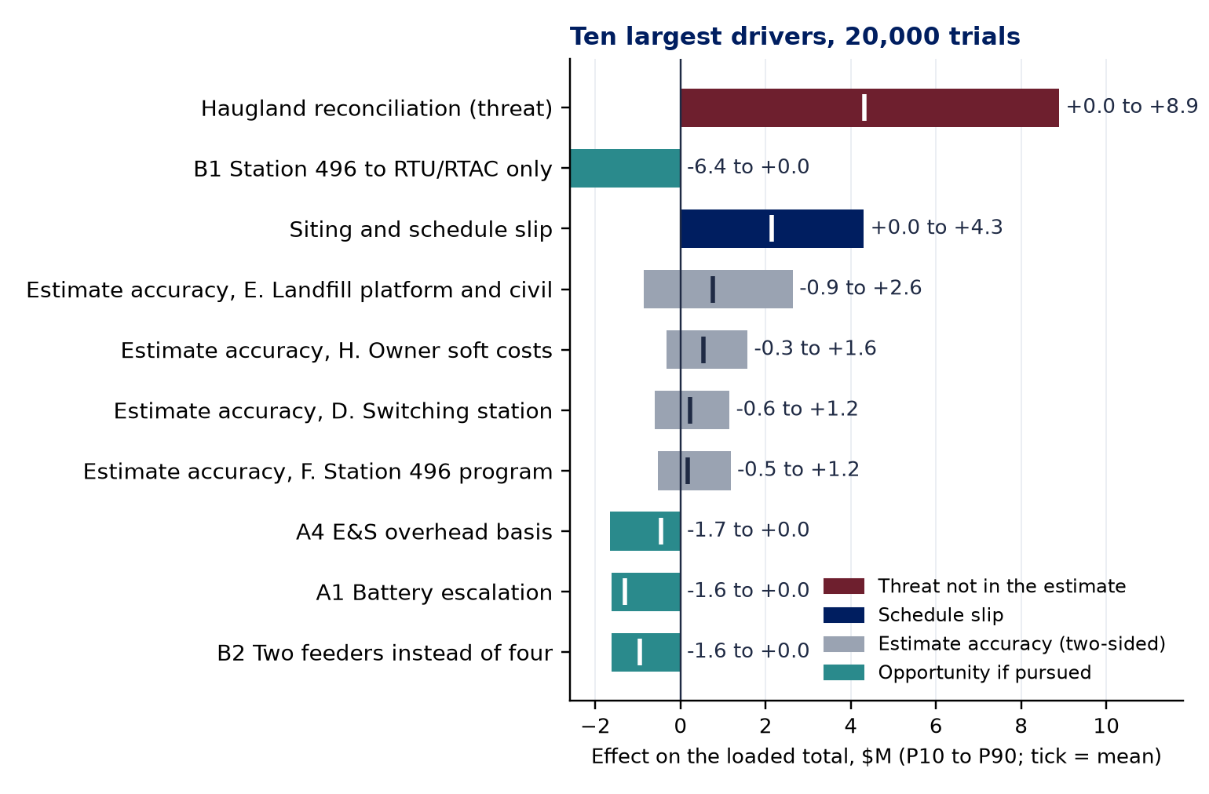
WHAT MUST BE MANAGED SO THE SAVINGS STICK
Two risks can eat every dollar saved: the Haugland reconciliation and the siting calendar. Both have an owner and a date.
▪ Haugland reconciliation, +$4 to 8M direct, 43% of the variance. Haugland's Class 3 base for overlapping scope is $19.2M; Rev 3 carries $8.3M. Until a signed scope map says which is right, every saving on slides 4 and 5 is provisional. Owner: PM + Cost Estimating + HEG. By: before the November PAF.
▪ Siting schedule, +5 months at P50, +9 at P80, 11% of the variance. Every month costs about $0.37M in AFUDC, escalation and PM. Action: file Article 80 early, pre-brief the abutters on screening and sound, set the ZBA date within 90 days of filing. Owner: Siting + PM. By: Q1 2027.
▪ Station 496 is now the second driver, 26% of the variance. A $6M swing that turns on one protection-basis memo; until it is signed the number has two modes.
▪ Exposures to carry honestly, $2.0 to 3.9M. Sound mitigation ($467K dropped from the 2023 estimate), visual screening, police details, NFPA 855 changes, the GSU count. Price them now; a surprise in 2028 costs more than a line today.
▪ Everything on the left is ours to take. No single lever exceeds $2M; together they are worth about $9.9M at the assessed odds and $16.8M if every one lands.
EstimatingCoE | Eversource Energy | Stewards of Affordability
10
Notes:
Tornado from the integrated Monte Carlo (20,000 trials, mc_scope_schedule.py): each driver's P10 to P90 effect on the loaded total. Variance shares are Spearman contributions to the spread of the managed outcome. The leadership point: the downside is concentrated in two items with owners, the upside is distributed across sixteen items that are mostly decisions.

Slide 11
SAVE, CONTAIN, REDUCE
The plan on one page: five gates, each with an owner, a date and the dollars it decides
When | What | Who | What it decides
Now to the Nov 2026 PAF | The six no-study decisions (A1, A2, A4, A5, B5, C3); sound mitigation and screening priced or registered; the 48E memo opened with Tax | Cost Estimating, PM, Accounting, Tax | Estimate hygiene, about $3M to $5M loaded; the exposures carried honestly
Gate 1, design basis (Q1 2027) | Geotech report; NFPA 855 hazard mitigation analysis; hosting-capacity and protection study at 5 MW per feeder; Station 496 protection-basis memo; GSU count and topology in writing; Haugland-to-Rev 3 scope map signed | Substation Eng., Civil, System Planning, System Protection, HEG | The Station 496 case ($6.1 to 6.6M), the two-feeder case ($1.5 to 1.7M), the civil layer, the GSU exposure, the Haugland gap
Gate 2, design-to-cost (before IFC, mid-2027) | Station-direct target of $1,250 per kWh and $50M loaded; monthly trend review; change control board with the CoE; no scope added without a funded source | PM (accountable), Cost Estimating, sponsor | Turns the estimate into a managed number instead of a forecast
Gate 3, commercial strategy (Q3 2027) | Competitive lump-sum pricing for station, civil and install (Haugland plus two); owner-furnished GSUs and skids; Nomad milestones aligned to delivery; change-order cap; Station 496 outage windows priced | Sourcing, PM, Construction | Converts unit-library construction into a bid; retires the +25% construction stress test
Standing, monthly to in-service | One-page cost-containment report: station-direct $/kWh against target, forecast at completion, open scope questions, exposures register, the 48E and FEOC milestones | PM, CoE | What leadership sees every month
Target: $1,250 per kWh station-direct ($25M direct, $50M loaded); the CoE reports the trend monthly from the November 2026 PAF.
EstimatingCoE | Eversource Energy | Stewards of Affordability
11
Notes:
The containment plan from scope_challenge.json. The first gate is the November 2026 PAF; it carries the six no-study decisions and the honest exposures. Gate 1 closes the studies. Gate 2 sets the target. Gate 3 sets the contracting strategy. The standing item is the monthly report.

Slide 12
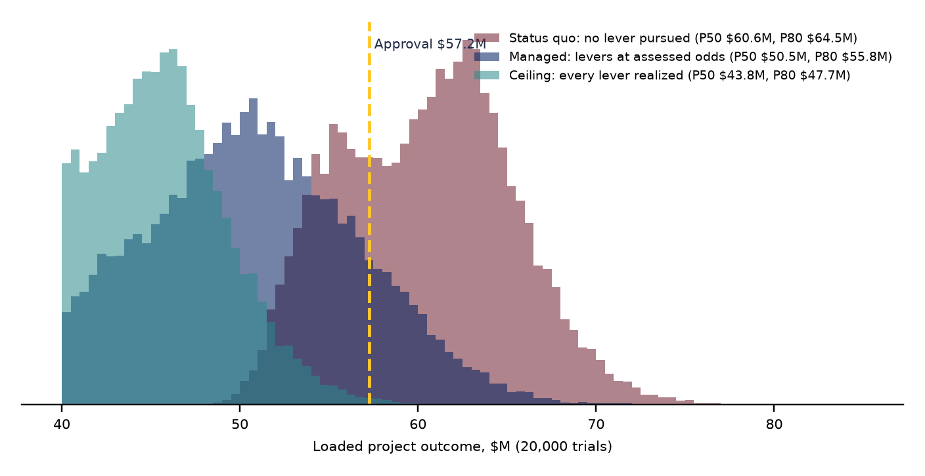
20,000 TRIALS ON COST, SCOPE AND SCHEDULE
What the plan is worth: $10.1M at the median if the levers are worked at their odds, $16.8M if every one lands
Posture | P50 | P80 | Over $57.2M
Nothing pursued | $60.6M | $64.5M | 70%
Levers at their odds | $50.5M | $55.8M | 14%
Every lever lands | $43.8M | $47.7M | 0%
▪ Read it plainly: with nothing pursued, 70% of trials end above the approval level, because the Haugland gap, the unpriced exposures and the schedule are real and the estimate carries none of them.
▪ With the plan: the median lands at $50.5M and 47% of trials come in under $50M.
▪ The reserve: $7.6M of risk and contingency covers the modeled ranges at about P75 only if the plan is executed.
EstimatingCoE | Eversource Energy | Stewards of Affordability
12
Notes:
Integrated Monte Carlo (mc_scope_results.json): base = approval less reserves ($49.6M), plus layer accuracy ranges, plus threats not in the estimate at their odds, plus schedule cost, less the levers at their assessed odds (managed) or at full value (ceiling). Schedule: P50 slip 5 months, P80 9 months, 39% chance of more than 6 months.

Slide 13
DECISIONS REQUESTED TODAY
$57M becomes $38.5 to 42.9M through sixteen named levers, three gates and one target. Six of them need only a yes.
▪ 1. Approve the six no-study corrections for the November 2026 PAF ($4.9 to 7.0M loaded). Owners: Cost Estimating, PM, Accounting, Sourcing.
▪ 2. Fund the four closers now (geotech, hosting capacity at 5 MW per feeder, the Station 496 protection-basis memo, the Haugland scope map) so the eight study-gated levers ($10.6 to 13.1M), led by Engineering's Station 496 and two-feeder proposal, are decided before IFC.
▪ 3. Open the Section 48E memo with Tax this month ($8.4 to 12.4M on the revenue requirement; FEOC cell-origin test on the Nomad units).
▪ 4. Adopt the design-to-cost target ($1,250 per kWh station-direct, $50M loaded) with change control and a monthly report from the CoE.
▪ 5. Approve competitive lump-sum pricing of the station, civil and install scope at Gate 3, with owner-furnished GSUs and skids.
▪ 6. Assign the two risks that can undo all of it: the Haugland reconciliation (PM + Cost Estimating + HEG, before the PAF) and the siting calendar (Siting + PM, Q1 2027).
EstimatingCoE | Eversource Energy | Stewards of Affordability
13
Notes:
Mirror of the open. This slide stays up during discussion. Each decision maps to a gate on slide 10 and to a row in the savings register in the workbook.

Slide 14
APPENDIX: SAVINGS REGISTER, $15.1 TO 19.5M ON THE ESTIMATE, $11.6 TO 17.2M ON THE REVENUE REQUIREMENT
Backup: the sixteen levers as sized from the Rev 3 line items
# | Lever | Layer | Direct | Loaded | Conf. | Owner
A1 | Remove escalation carried on the fixed-price Nomad balance | A | $1.1M | $1.6M | High | Cost Estimating / Sourcing
A2 | Risk register: labor-cost and material-cost lines overlap the escalation already in the directs | J | $1.3 to 1.8M | $1.3 to 1.8M | Medium | Cost Estimating + PM
A3 | Confirm the four written design-basis items Haugland priced as deducts | D/E | $0.6 to 0.8M | $0.9 to 1.2M | Medium | Substation Engineering
A4 | Engineering & supervision overhead basis applied to the vendor turnkey contract | L | $1.0 to 2.1M | $1.0 to 2.1M | Low | Accounting / Cost Estimating
A5 | Commissioning hours carried from E-23-373 overlap Nomad's commissioning support | G | $0.1 to 0.3M | $0.2 to 0.5M | Low | Capital Projects Eng. + Nomad
B1 | Station 496: relay program out; RTU, RTAC and transfer trip only (Engineering, 5 Oct 2026) | F | $6.1 to 6.6M | $6.1 to 6.6M | Medium | P&C Engineering + System Protection
B2 | Two feeders instead of four: two skids, two metering sets, two duct-bank runs (Engineering, 5 Oct 2026) | C/D | $1.0 to 1.2M | $1.5 to 1.7M | Medium | System Planning + Substation Eng.
B3 | Platform and retaining wall sized after geotech, not before | E | $0.3 to 0.8M | $0.4 to 1.2M | Low | Civil + Capital Projects Eng.
B4 | Battery installation labor from a crew build-up instead of 25% of a 2023 total; fire suppression bought twice? | B | $0.5 to 0.7M | $0.7 to 1.1M | Medium | Cost Estimating + Nomad + HEG
B5 | Disconnect switches and PT cutouts priced as separate lines although the Siemens skids carry them | D | $0.3M | $0.4M | High | Substation Eng. + Cost Estimating
B6 | GSU installation hours: 524 man-hours per pad-mount; count to be settled (four carried, twelve mentioned) | C | $0.2 to 0.2M | $0.3 to 0.3M | Medium | Substation Eng. + Nomad
B7 | Switchyard lighting: 12 HPS luminaires and $200 a foot of hookup on an unmanned one-acre pad | D | $0.2M | $0.2 to 0.3M | Medium | Substation Eng.
B8 | Siting and project management: external siting at $1.05M and a $157K siting line inside Station 496 | H/F | $0.4 to 0.6M | $0.5 to 0.8M | Low | Siting + PM
C1 | Section 48E investment tax credit on the storage property | rev. req. | $8.4 to 12.4M | $8.4 to 12.4M | Medium | Tax + Regulatory
C2 | Energy-community adder if the closed landfill qualifies as a brownfield | rev. req. | $2.8 to 4.1M | $2.8 to 4.1M | Low | Tax + Environmental
C3 | AFUDC: pay the battery at delivery, not a year ahead; protect the siting float | M | $0.3 to 0.7M | $0.3 to 0.7M | Medium | PM + Sourcing + Treasury
Full basis, evidence lines and what must close for each lever: Hyde Park BESS Cost Analysis Deck slides 27 to 36, Whitepaper section 8, Workbook tabs Savings Register and Scope Challenge.
EstimatingCoE | Eversource Energy | Stewards of Affordability
14
Notes:
Backup only.

